Slide 1
1. General Questions:
a. What are the subjects offered in Program A, Program B, and Program C?
b. Who are the faculty members for Program A, Program B, and Program C?
c. What are the start and end dates for Program A, Program B, and Program C?
2. Branch-specific Questions:
a. In Branch A of Program A, how many students have completed the program, joined new, and are currently ongoing?
b. Who is the faculty member for Branch A in Program A?
c. In Branch B of Program B, how many students have completed the program, joined new, and are currently ongoing?
d. Who is the faculty member for Branch B in Program B?
e. In Branch A of Program C, how many students have completed the program, joined new, and are currently ongoing?
f. Who is the faculty member for Branch A in Program C?
g. In Branch B of Program C, how many students have completed the program, joined new, and are currently ongoing?
h. Who is the faculty member for Branch B in Program C?
3. Timeframe Questions:
a. When does Program A start and end?
b. When does Program B start and end?
c. When does Program C start and end?
d. Which program has the shortest duration, and which one has the longest duration?

Slide 2
4. Faculty-related Questions:
a. Who are the faculty members common to all three programs?
b. Who is the faculty member with the most students in all branches combined?
c. Which faculty member has the most students in a single branch?
5. Subject-related Questions:
a. What are the subjects common to all three programs?
b. Which program offers the most subjects, and how many subjects is that?
6. Enrollment and Completion Questions:
a. Which program has the highest number of students who have completed their studies?
b. In which branch is the highest number of students currently ongoing?
c. Which program has the highest number of students who joined recently?

Slide 3
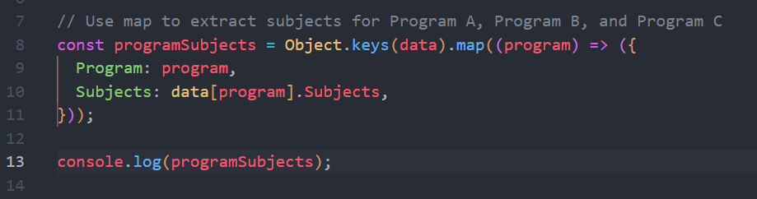
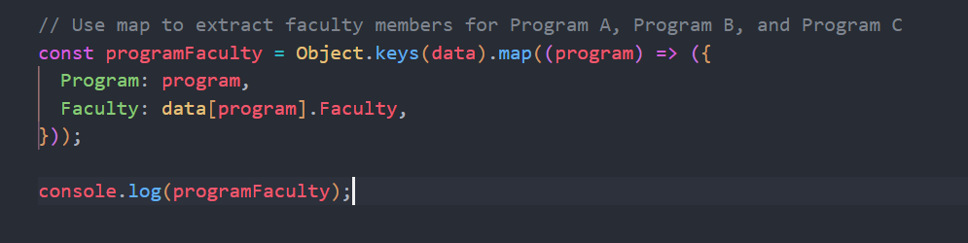
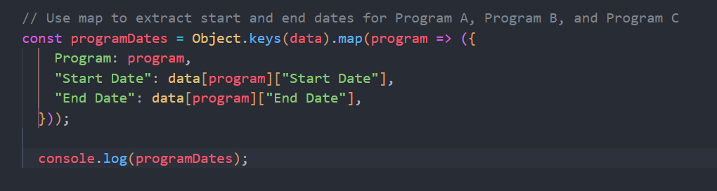

Slide 4
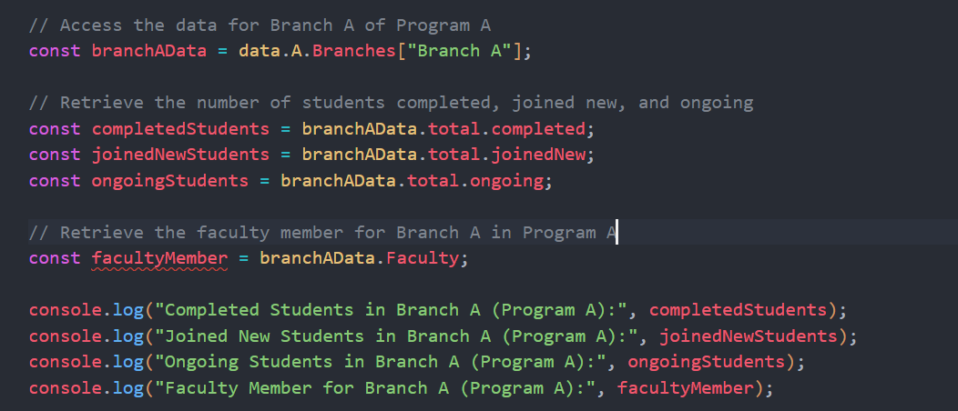

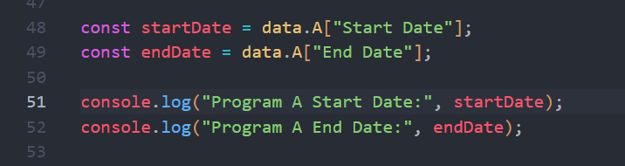

Slide 5
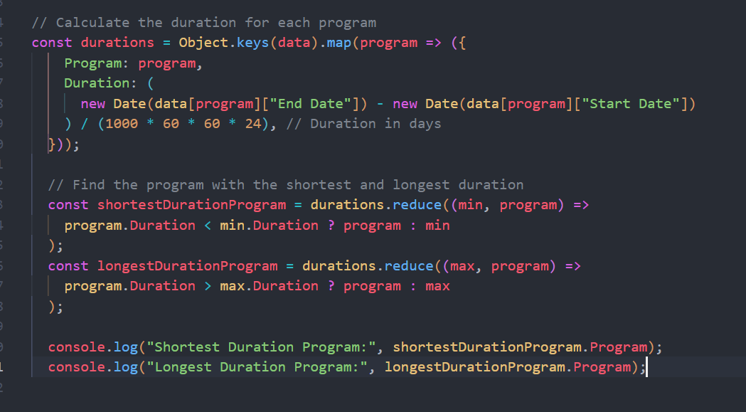

Slide 6
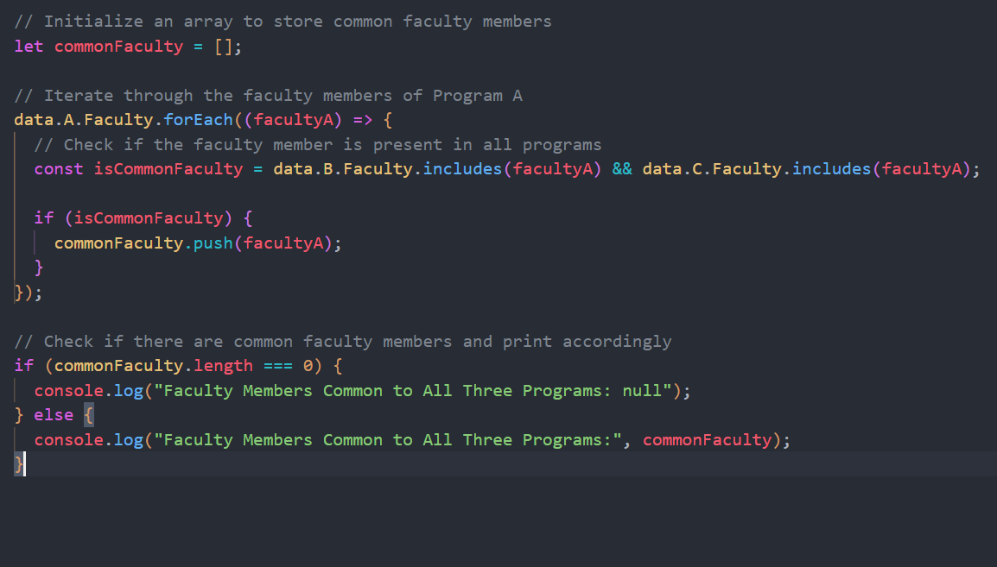

Slide 7
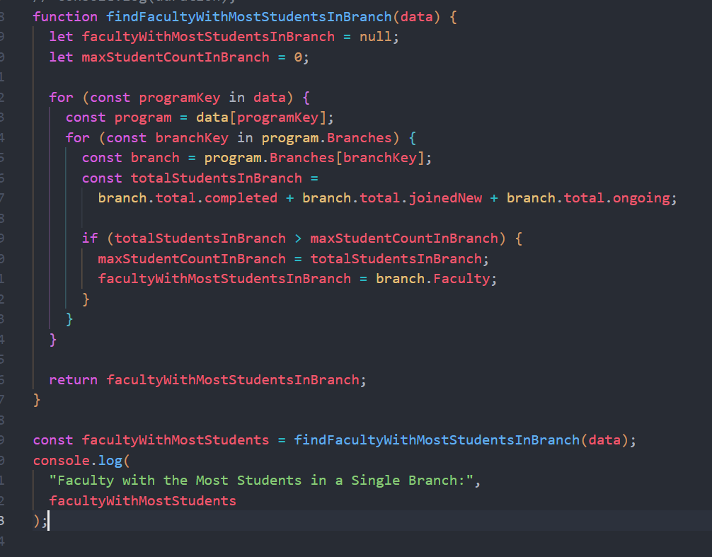

Slide 8
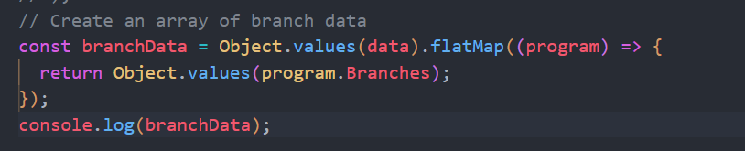
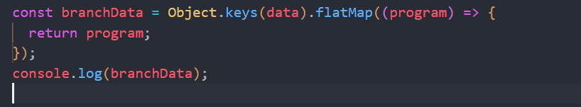
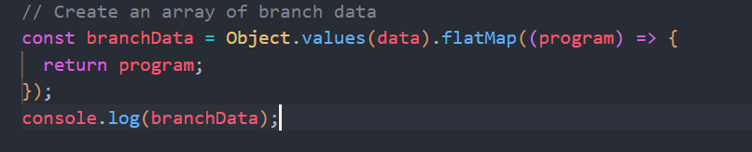
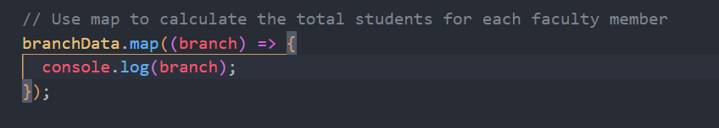

Slide 9
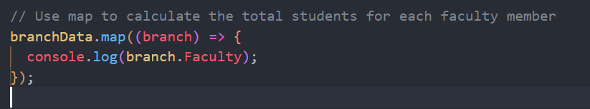
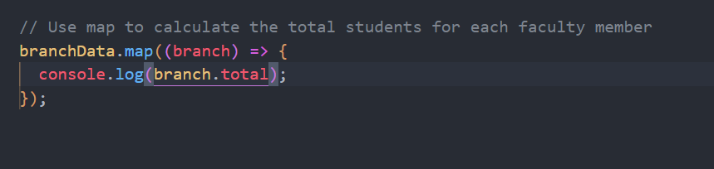
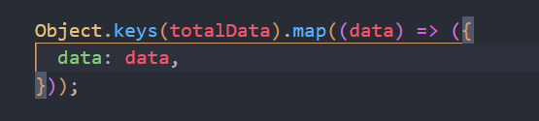

Slide 10
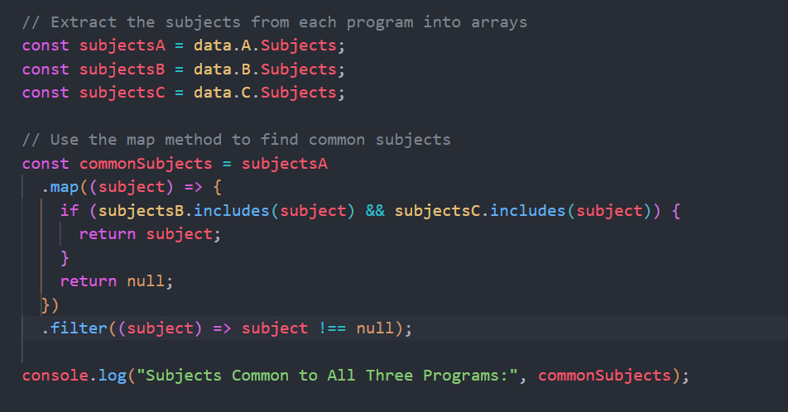

Slide 11
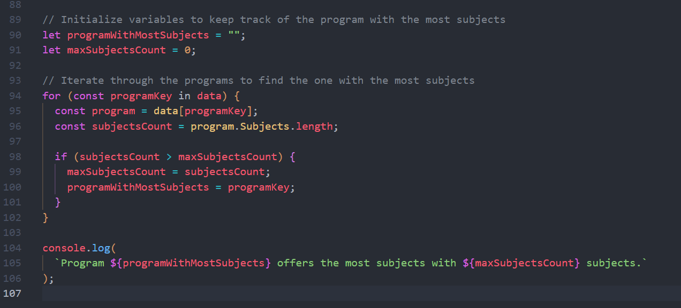

Slide 12
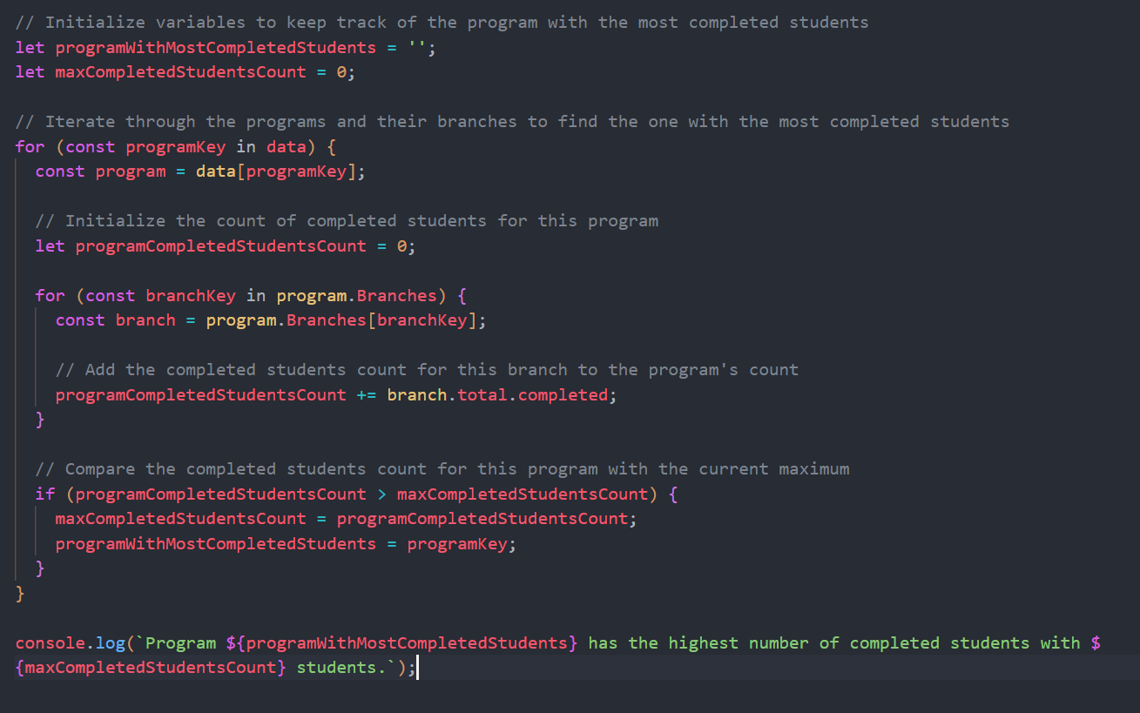

Slide 13
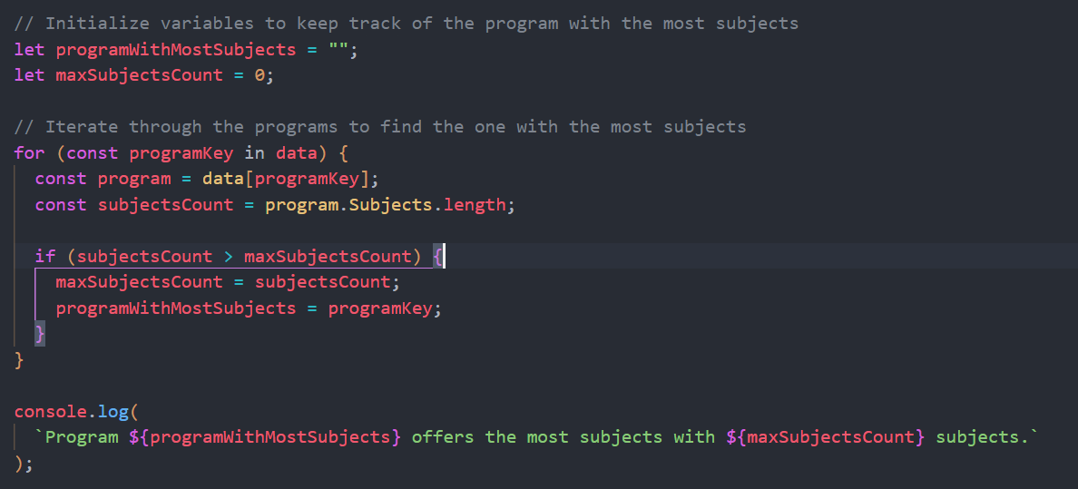

Slide 14
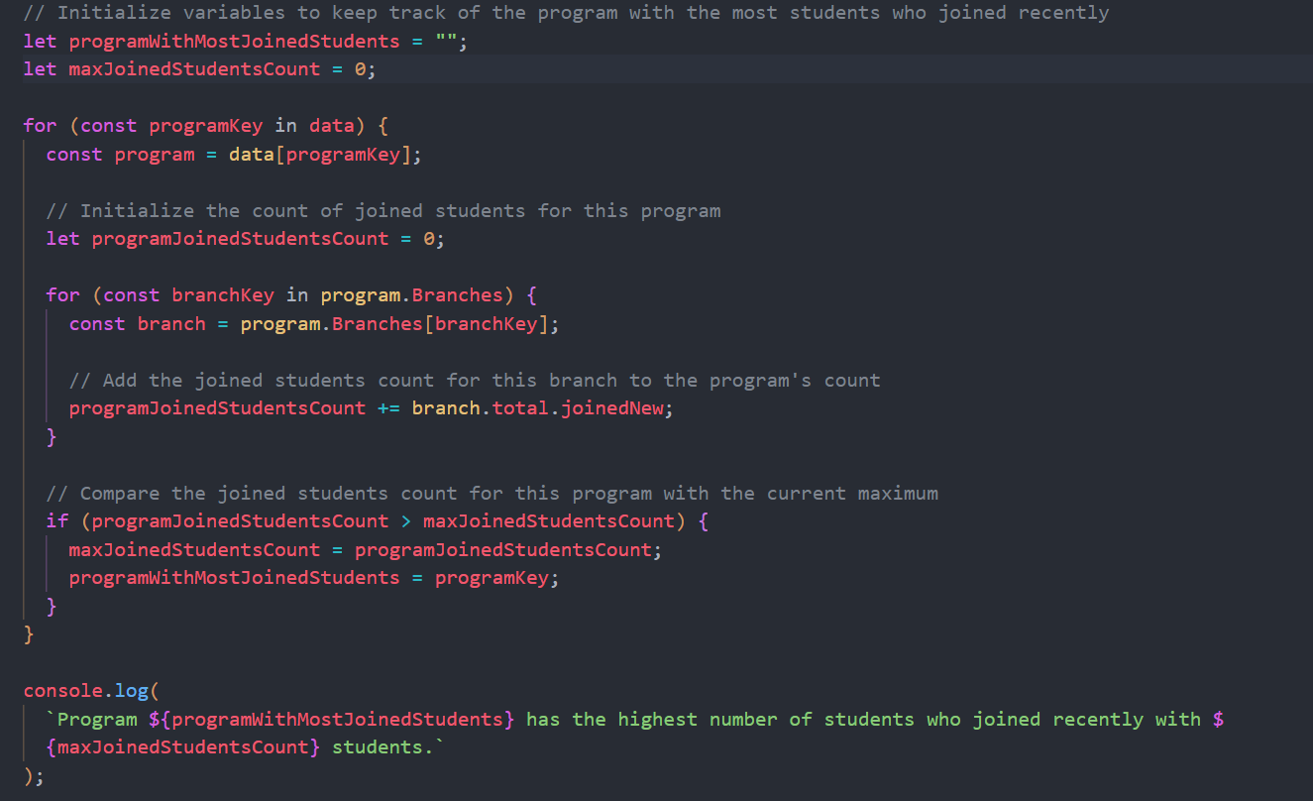

Slide 15
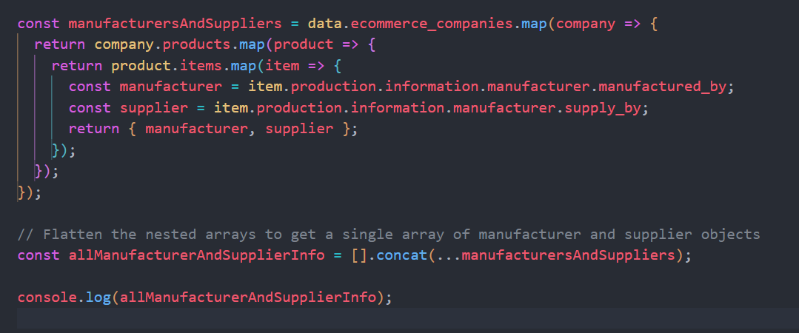

Slide 16
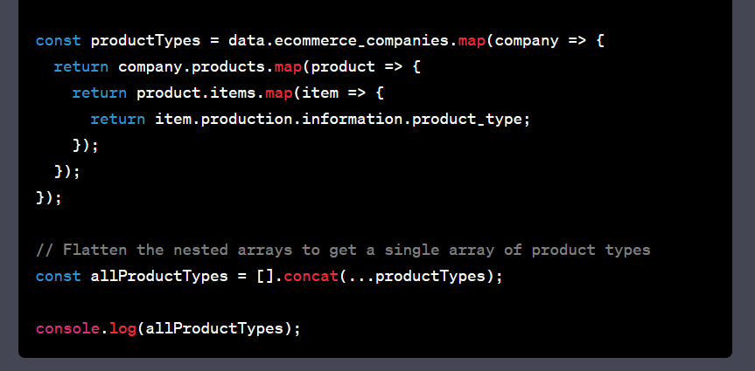
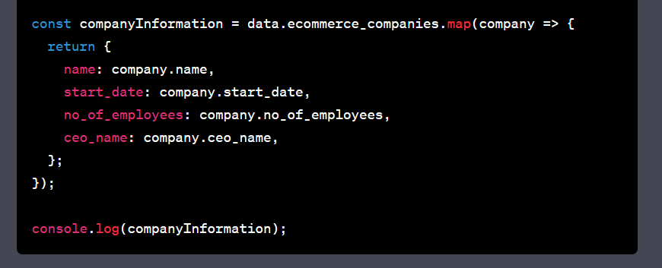

Slide 17
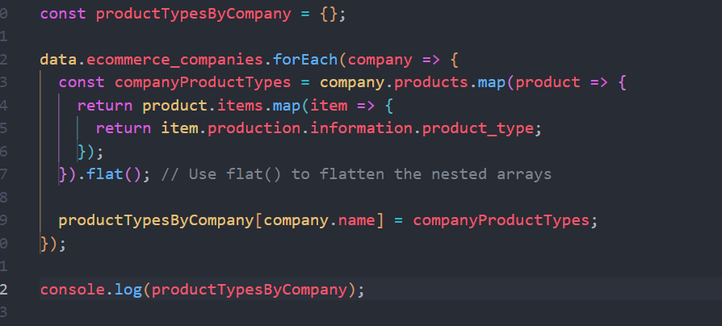

Slide 18
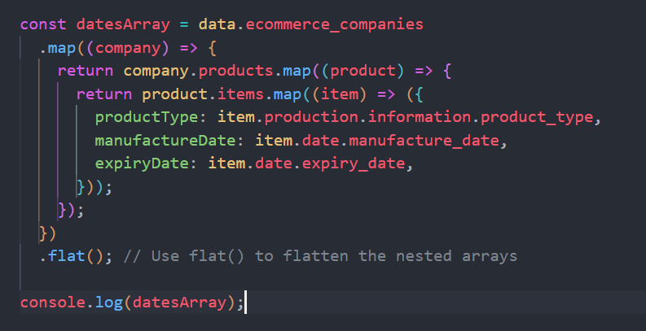

Slide 19
